Slide 1
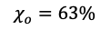
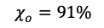
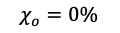
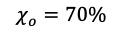
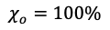
Externally
mixed
Internally
mixed
$$χ_{a}=0\%$$
$$χ_{a}=20\%$$
$$χ_{a}=50\%$$
$$χ_{a}=80\%$$
$$χ_{a}=100\%$$
$$χ_{o}=0\%$$
$$χ_{o}=63\%$$
$$χ_{o}=70\%$$
$$χ_{o}=91\%$$
$$χ_{o}=100\%$$
$$χ_{h}=0\%$$
$$χ_{h}=67\%$$
$$χ_{h}=84\%$$
$$χ_{h}=96\%$$
$$χ_{h}=100\%$$

Slide 2
Page size: 2.1 (height) * 4 (width)
Figure size: 0.53 (height)*0.8 (width)
X: 0, 0.8, 1.6, 2.4, 3.2
Y: 0.17, 0.87, 1.57

